Slide 1
Hypocrisy
Hypocrisy
Hypocrisy
By: Nimah Hasan
By: Nimah Hasan

Slide 2
Description and Definition of a Hypocrite
A hypocrite (in Islam) is the one who saw, accepted, and embraced Islam. When his life style was challenged and tested, Islam had failed with him. He knew the reason why he was not following Islam. It was because Islam was taking away a certain thing that he liked or that he already adopted. It was too important to him to let go.
Reported by Ammar ibn Yasir, an early companion of the Prophet, who quotes him as saying: “Whoever is double-faced in this life will have two tongues of fire in the hereafter. (Related by Al-Bukhari in Al-Adab Al-Mufrad, Abu Dawood, Al-Darimi and others).

Slide 3
Examples of Hypocrites
Examples of Hypocrites
An example of a hypocrite would be a person who does not pray their 5 payers. If they do pray, they do it to be recognized by people. They also refuse to do good.
A person who is more attached to worldly
matters then Allah (SWT).
A person who breaks his or her promise.
An example of a hypocrite would be a person
who lies when he speaks.

Slide 4
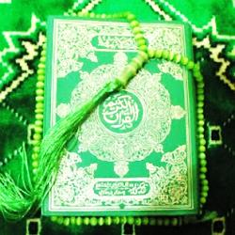
Evidence and Support From the Quran and Hadith
Evidence and Support From the Quran and Hadith
Allah says : "And when they meet those who believe, they say: "We believe," but when they are alone with their Shayaateen (devils - polytheists, hypocrites), they say: "Truly, we are with you; verily, we were but mocking, Allah mocks at them and gives them increase in their wrong- doing to wander blindly"[al-Baqarah 2:14-15]
Reported on the authority of Abu Huraira that the Messenger of Allah (may peace and blessings be upon him) said: There are three signs of a hypocrite: when he spoke he told a lie, when he made a promise, he acted treacherously against it, when he was trusted he betrayed. (Muslim and Bukhari)
Allah says : "And when they meet those who believe, they say: "We believe," but when they are alone with their Shayaateen (devils - polytheists, hypocrites), they say: "Truly, we are with you; verily, we were but mocking, Allah mocks at them and gives them increase in their wrong- doing to wander blindly"[al-Baqarah 2:14-15]
Reported on the authority of Abu Huraira that the Messenger of Allah (may peace and blessings be upon him) said: There are three signs of a hypocrite: when he spoke he told a lie, when he made a promise, he acted treacherously against it, when he was trusted he betrayed. (Muslim and Bukhari)

Slide 5
Connections to Tonicity and Cell Membrane
A hypocrites heart relates to the hypertonic, isotonic, and hypotonic heart.
It relates to the hypotonic heart because the cell membrane is broken, so it allows all the bad things to come inside the heart. There is to much bad in the heart.
If the hypocrite decides to repent, then slowly his heart will turn hypertonic. At the end, the heart will become isotonic after it is cured.

Slide 6
Cure and Prevention of Hypocrisy
Cure and Prevention of Hypocrisy
Except those who repent and amend and hold fast to Allah and are sincere in their religion to Allah, these are with the believers, and Allah will grant the believers a mighty reward.[Al- Nisa 4: 146]
The verse mentioned above says that there are four necessary conditions of leaving hypocrisy.
1- He must repent. He has to be ready to worship Allah (SWT) alone.
2- He should change himself as well as his deeds.
3- He should attach himself to Allah. His heart should remember Allah all the time. Whatever he does, is for the sake of Allah.
4- He should devote his religion only for Allah.
The prevention of hypocrisy is stay away from the things Allah will dislike.
Hypocrisy is a serious sickness.

Slide 7
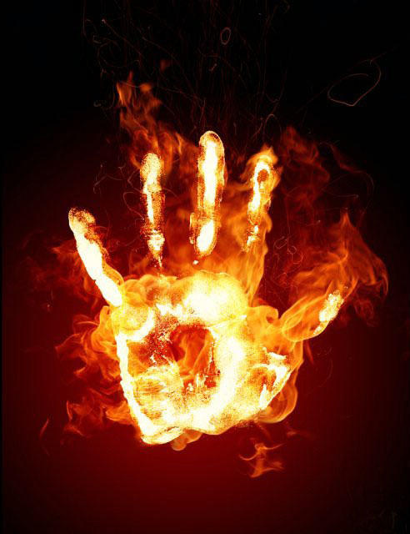
What is a Hypocrites Punishment?
What Are the Punishments if YOU Are a Hypocrite?
Allah (SWT) has decided that the hypocrites as well as the
disbelievers will be in Hell.
Allah (SWT) says: "Surely, Allah will
collect the hypocrites and disbelievers all together
in Hell“ [al-Nisa 4:140]
But because of the major harm hypocrite’s cause, the
hypocrites will be in the lowest level of Hell.
Allah says: "Verily, the hypocrites will be
in the lowest depth (grade) of the Fire"[al Nisa 4:145]

Slide 8
Be strong in your eman. If you’re a hypocrite, change yourself before death comes to you…
Be strong in your eman. If you’re a hypocrite, change yourself before death comes to you…

Slide 9
Bibliography
"Muslimah." Muslimah. N.p., n.d. Web. 30 Apr. 2013.
"Multimedia." إسلام ويب. N.p., n.d. Web. 30 Apr. 2013.
World Of Islam: Hypocrisy (An-Nifaq). Web. 30 Apr. 2013.
"3 SIGNS OF A HYPOCRITE (HADITH)." Dailymotion. N.p., n.d. Web. 30 Apr. 2013.
"Islam Abhors All Types of Hypocrisy, Adil Salahi." Islam Abhors All Types of Hypocrisy, Adil Salahi. N.p., n.d. Web. 30 Apr. 2013.
"Qalbe Saleem, Immaculate Conscience." Qalbe Saleem, Immaculate Conscience. N.p., n.d. Web. 30 Apr. 2013.
"Study Shaikh Salih Al-Fawzaan's Aqeedah At-Tawheed." Study Shaikh Salih Al-Fawzaan's Aqeedah At-Tawheed. N.p., n.d. Web. 30 Apr. 2013.

