Slide 1
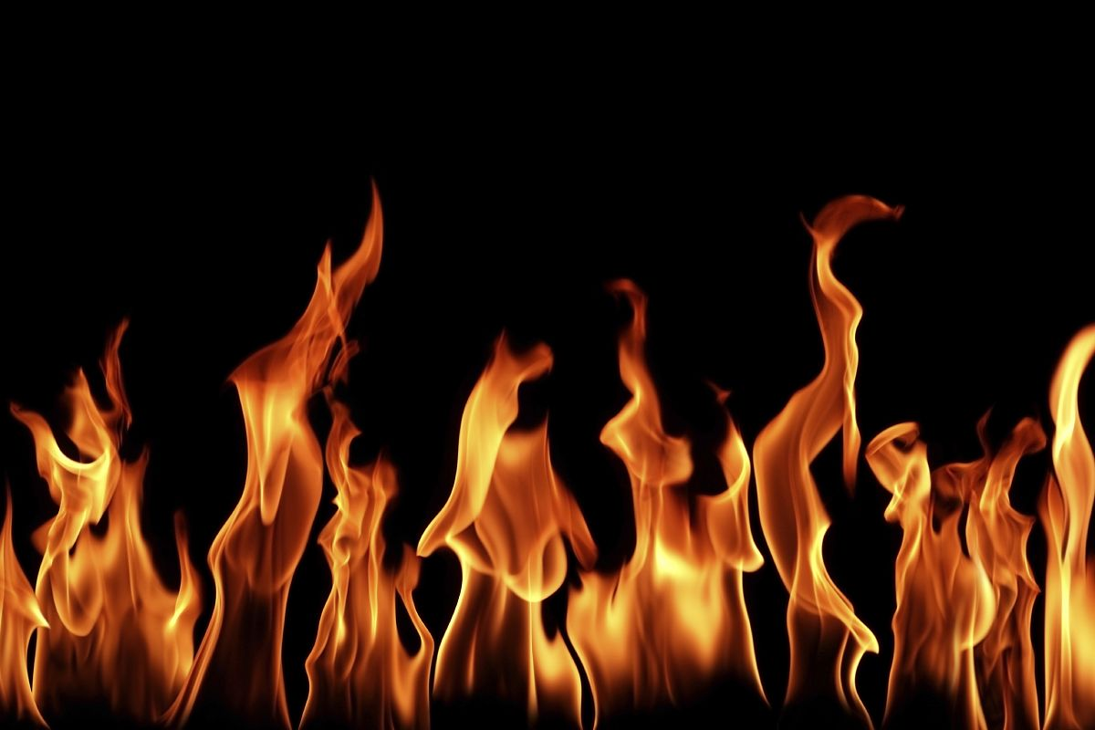
Anger
The fire of Shaytan
By: Issa Beck

Slide 2
What is anger?
Anger is described as a over powering emotion that is hard to hold back or hide
An example of this emotion is, If your younger sibling breaks one of your possessions and you react by hitting or yelling at your sibling that is anger

Slide 3
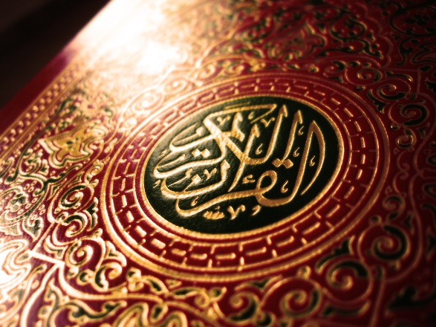
What the Quran and Sunah say about anger
The Quran and the Prophet (s.a.w) encourage people to avoid anger because it can lead to evil
According to a hadith, a man asked the Prophet "What is the worst thing that one incurs concerning God?" And the Prophet said, "His wrath." The man asked, "How do we avoid it?" The Prophet said, "Do not become angry."

Slide 4
Hypertonic (The weak heart)
Anger can relate to the sick or weak heart
Where you are not being patient with Allah’s trials
At this stage your faith is not dead nor is it healthy
At this stage your heart is on the border between a healthy heart and a dead heart

Slide 5
How to Prevent and cure this disease
The prophet (s.a.w) said that if one is angry sit down if you are still angry then lie down
Wudu is also another cure; anger is the fire of the shaytan and Wudu will put out the fire
This means that if you’re angry then try your best to calm down
It is said that if you wish to prevent anger then you should remain patient and remember humility, and remember that everything that happens is from Allah
The usual reason for anger comes from to much pride and form being impatient

Slide 6
Videos
http://www.youtube.com/watch?v=W-De5YxoKdg

Slide 7
Bibliography
(nmusba.wor..., AhleSunnah. "Purification of the Heart by Hamza Yusuf (Complete)." Scribd. N.p., 12 July 2012. Web. 30 Apr. 2013.
"Hadith Search Results." Search Hadith Library. N.p., n.d. Web. 30 Apr. 2013.

